Slide 1
22nd Task Force on Measurement and Modelling Meeting
10-12 May, 2021
Assessment of PAH pollution in the EMEP region: Case study on B(a)P for Poland,
EuroDelta-Carb multi-model study on B(a)P
A. Gusev, N. Batrakova, V. Shatalov, O. Rozovskaya, M. Kleimenov

Slide 2
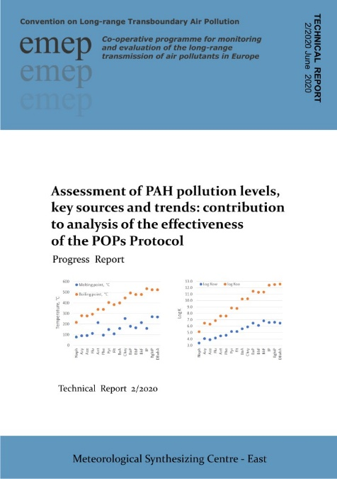
PAH pollution and population exposure
Contribution to analysis of POP Protocol effectiveness in co-operation with TFTEI, TFH (workplan 1.1.1.1)
Long-Term Strategy for the Convention (2020-2030):
“unintentional releases of PAHs are still a concern”
“continue scientific research on POP transport and trends with a focus on PAHs”
Main topics considered:
Case study on B(a)P/PAH pollution for Poland
Long-term changes of B(a)P pollution in the EMEP countries (1990-2018)
Contributions of key sectors to B(a)P pollution and their temporal changes
EuroDelta-Carb multi-model assessment of B(a)P pollution
Technical report 2/2021
MSC-E Technical report (2021)

Slide 3
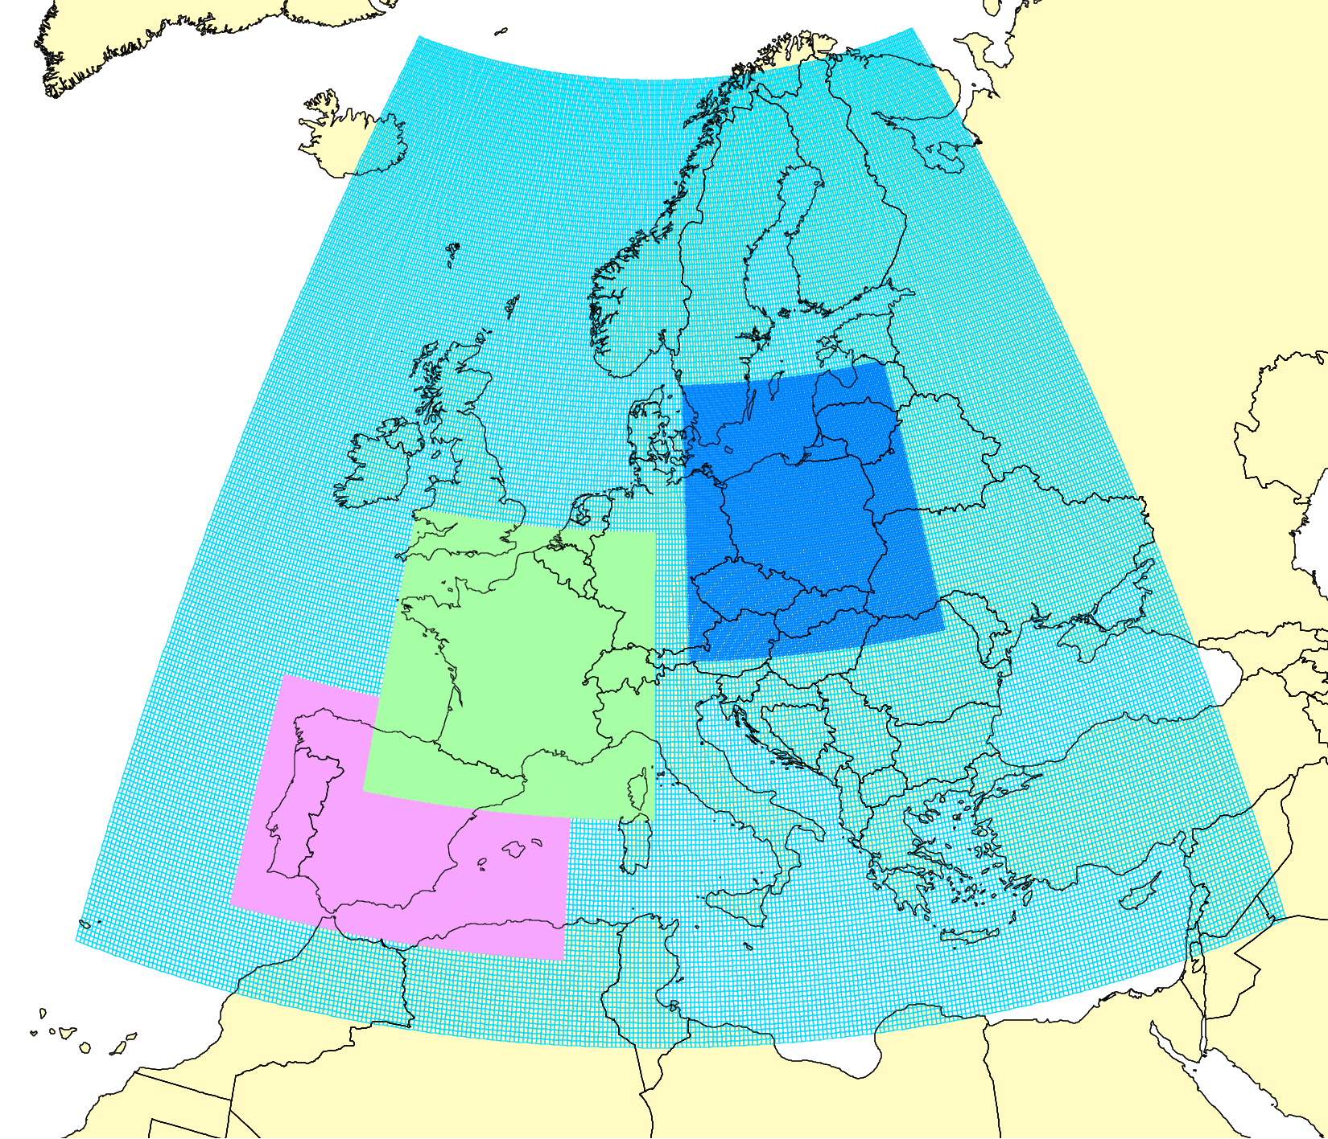
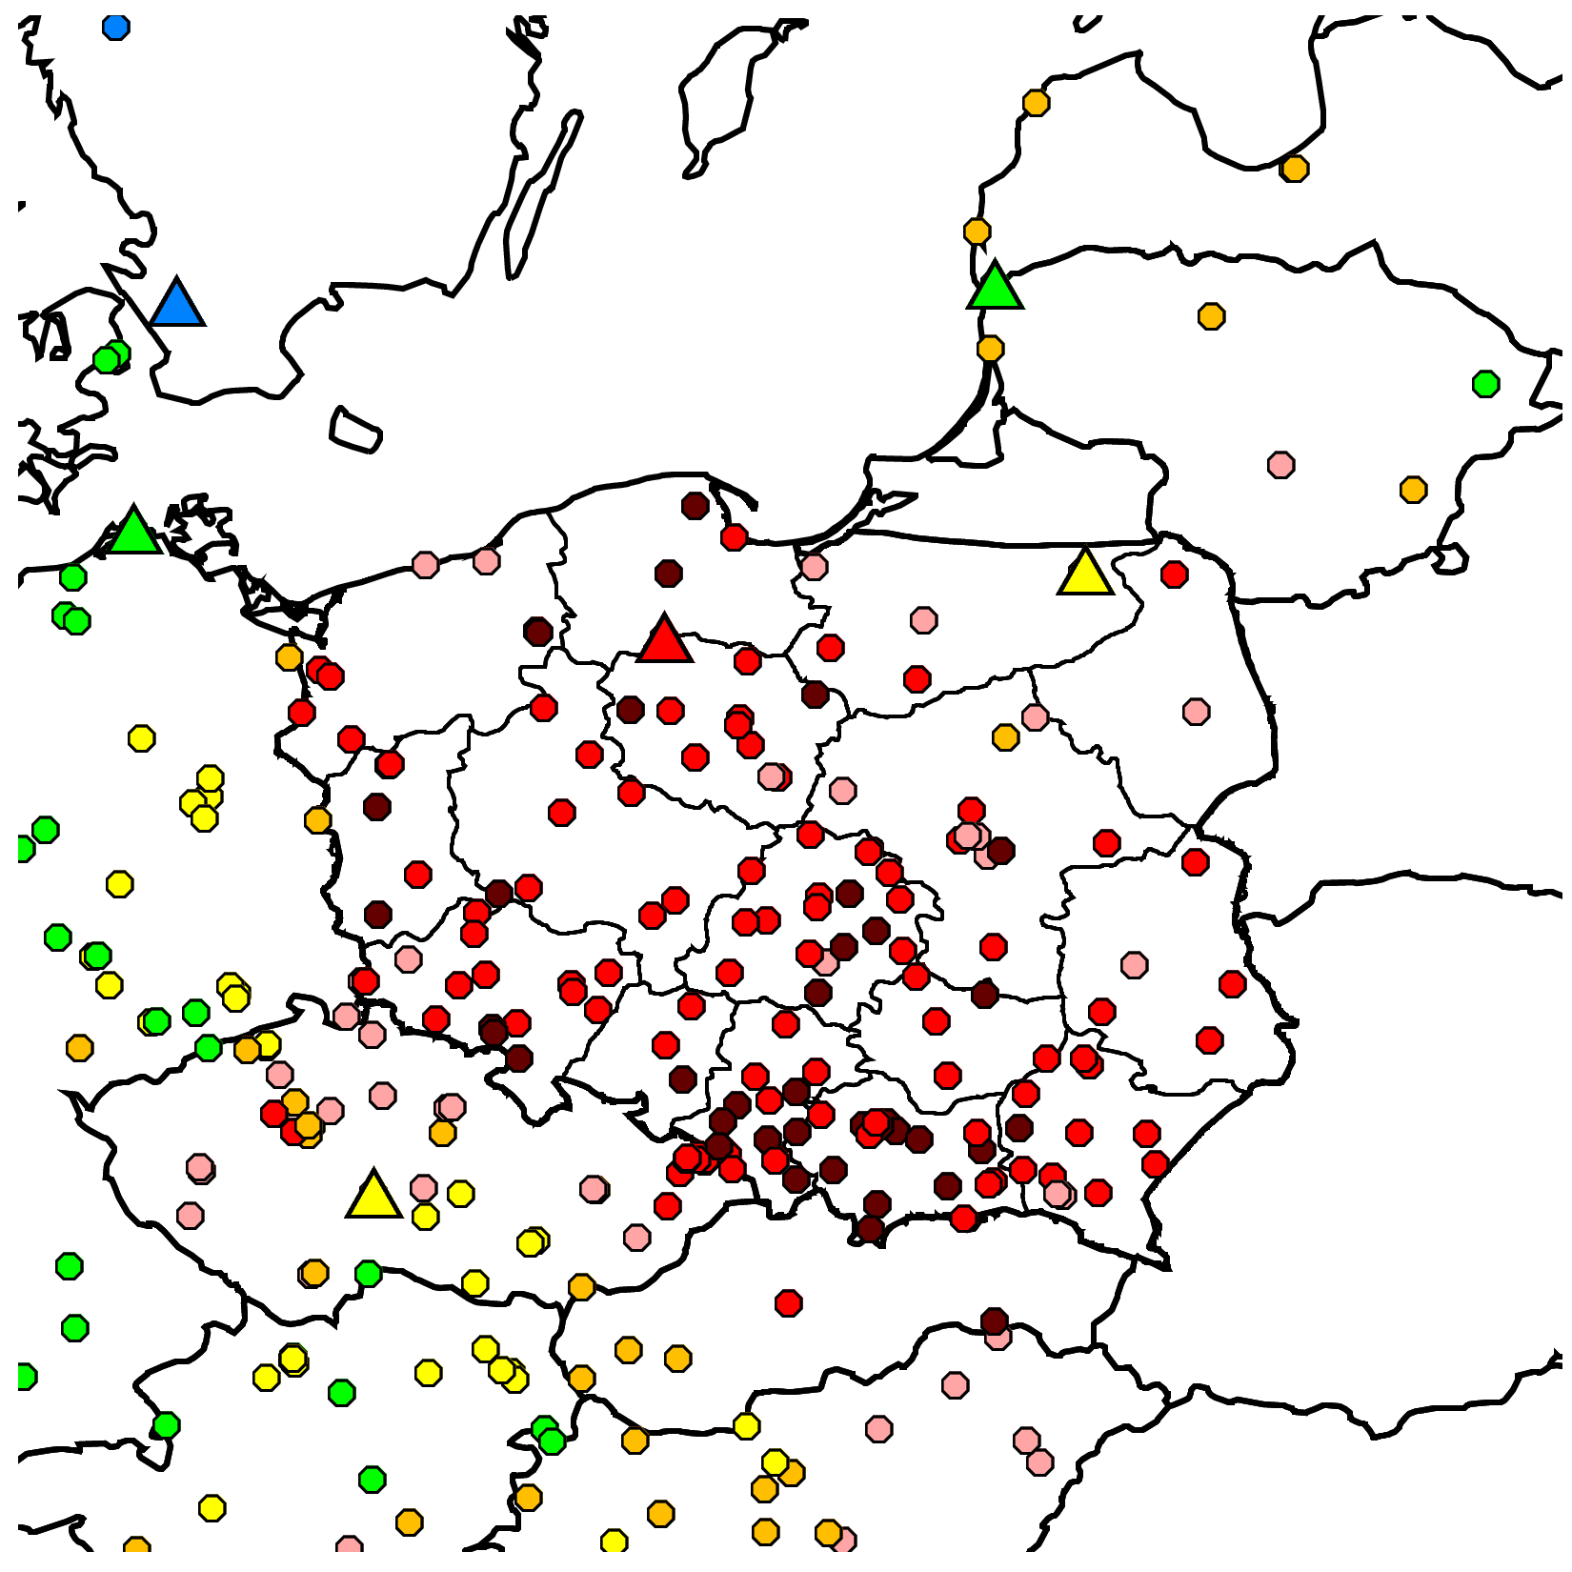
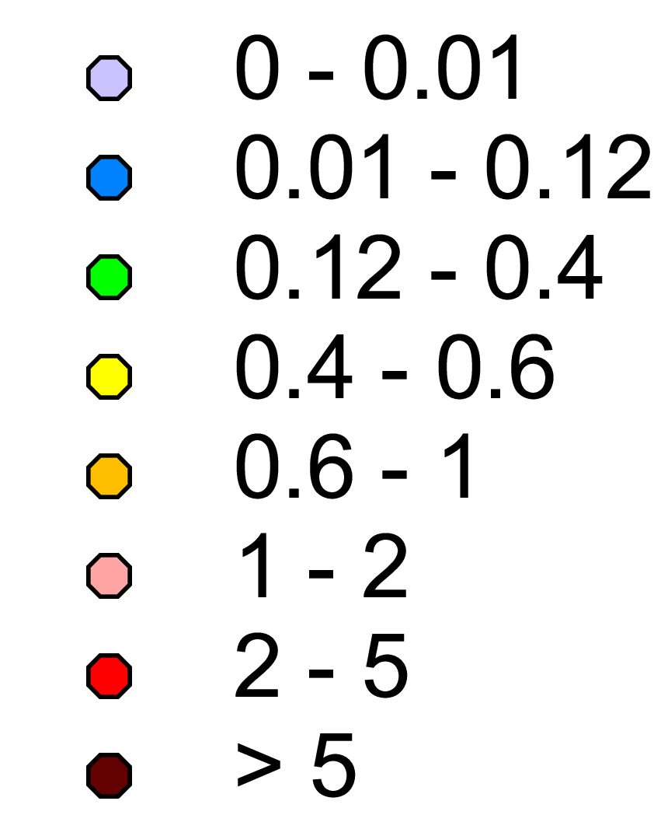
PAH assessment: case study on B(a)P/PAH pollution in Poland
Joint research to improve B(a)P/PAH pollution assessment (Spain, France, Poland)
Past/ongoing studies (2017-2021)
Meeting of MSC-E and national experts on emissions/modelling in Poland (Nov 2019)
Poland
Program of the study (2020-2022):
Simulations of B(a)P and B(b)F, B(k)F, I(cd)P levels in the country involving detailed national data
Model assessment using previous and updated national PAH emissions inventory of Poland
Experimental model simulations using scenario emissions
Estimation of exceedances of the EU and WHO air quality guidelines for PAHs
Inter-comparison of GLEMOS and GEM-AQ model results for B(a)P
France
Spain
Observed B(a)P conc (2018) EMEP+AIRBASE
B(a)P, ng m⁻³

Slide 4
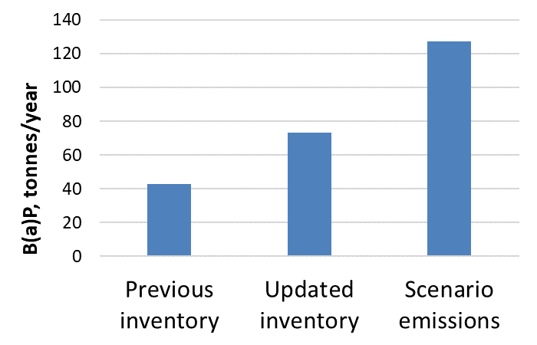
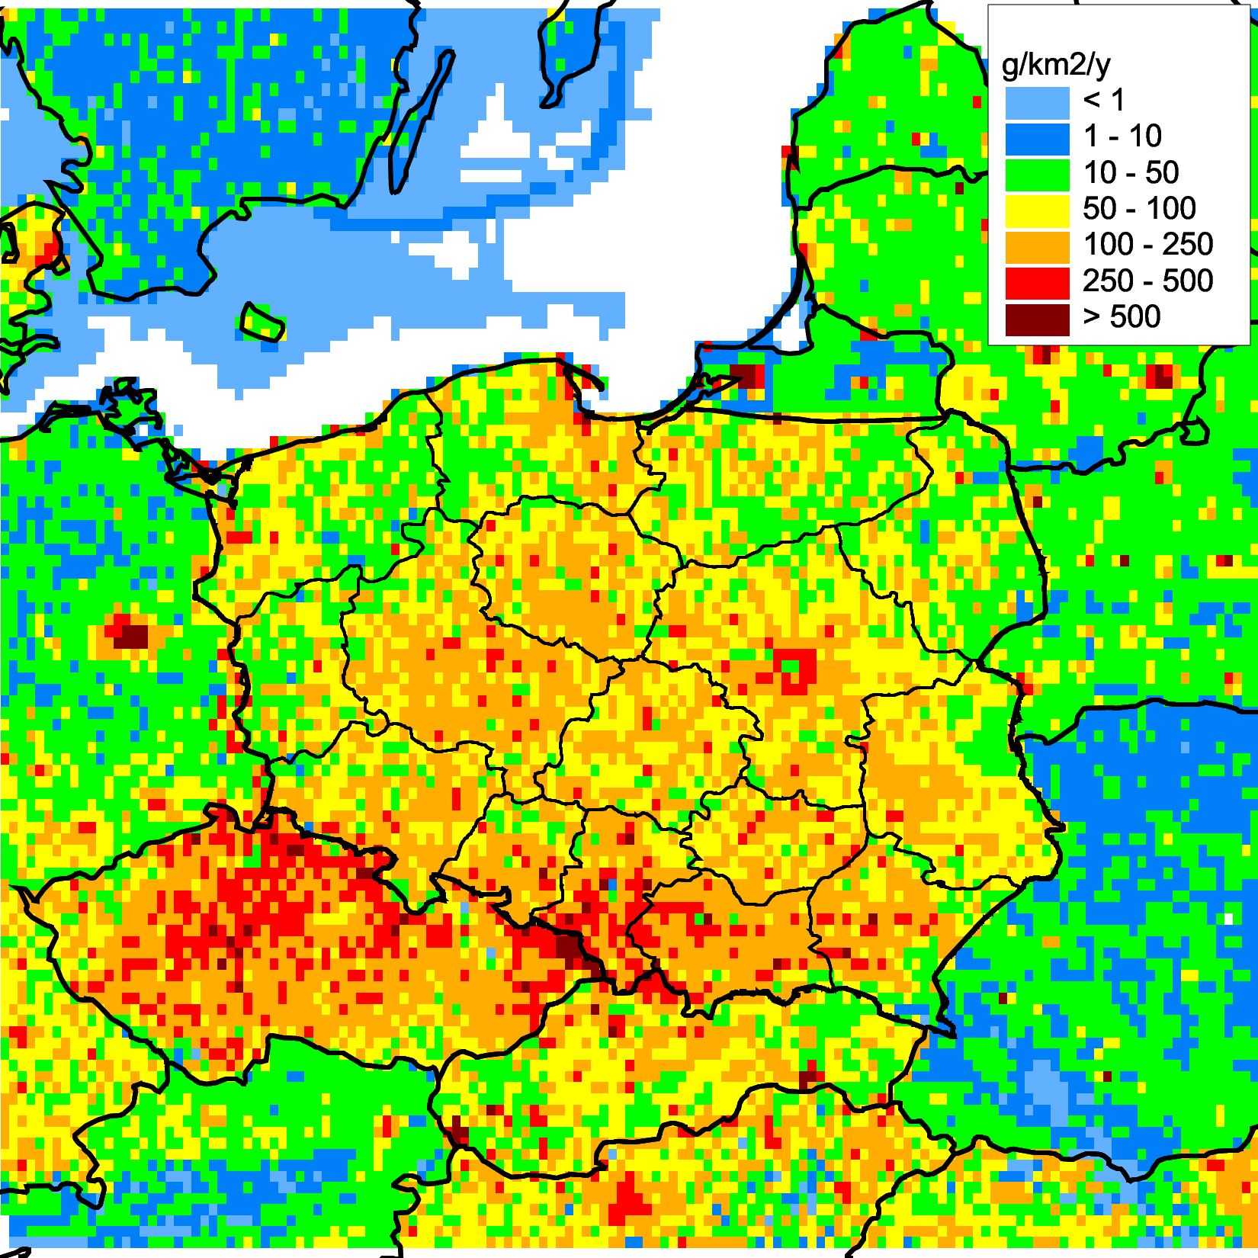
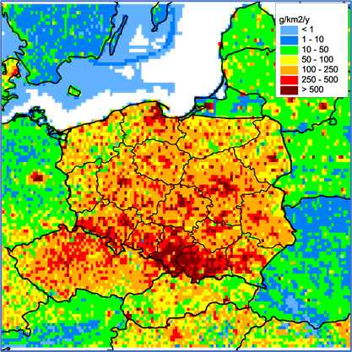
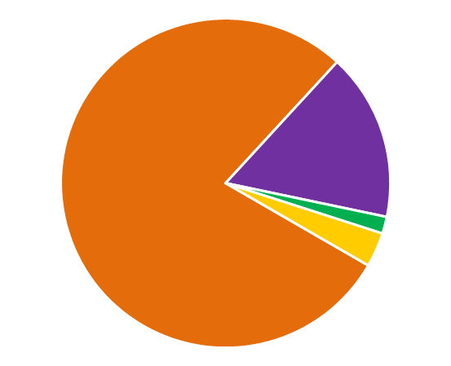
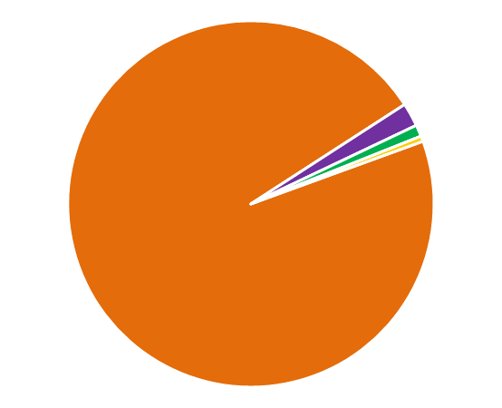
National inventory of PAH emissions in Poland
Updates of national PAH emission inventory (IIR 2020):
Revision of emission factors for PAHs emitted from combustion of solid fuels
Updated temporal changes of total PAH emissions in 1990-2018
Updated sector distribution with increased share of Residential combustion sector
Analysis of uncertainties for sectoral emissions (estimated uncertainty range for Residential combustion – 76%)
Total B(a)P emissions in Poland used for modelling
Long-term changes of B(a)P emissions
Spatial distribution of B(a)P emissions
Sector distribution of B(a)P emissions
Updated inventory
Previous inventory
Updated inventory
Previous inventory
Updated inventory
Fugitive
2%
Residential Combustion
79%
Fugitive
16%
Residential Combustion
96%
Scenario constructed by MSC-E based on uncertainty range for Res Comb sector
Waste
1%
Waste
2%
Other
0.5%
Previous inventory
Other
3%

Slide 5
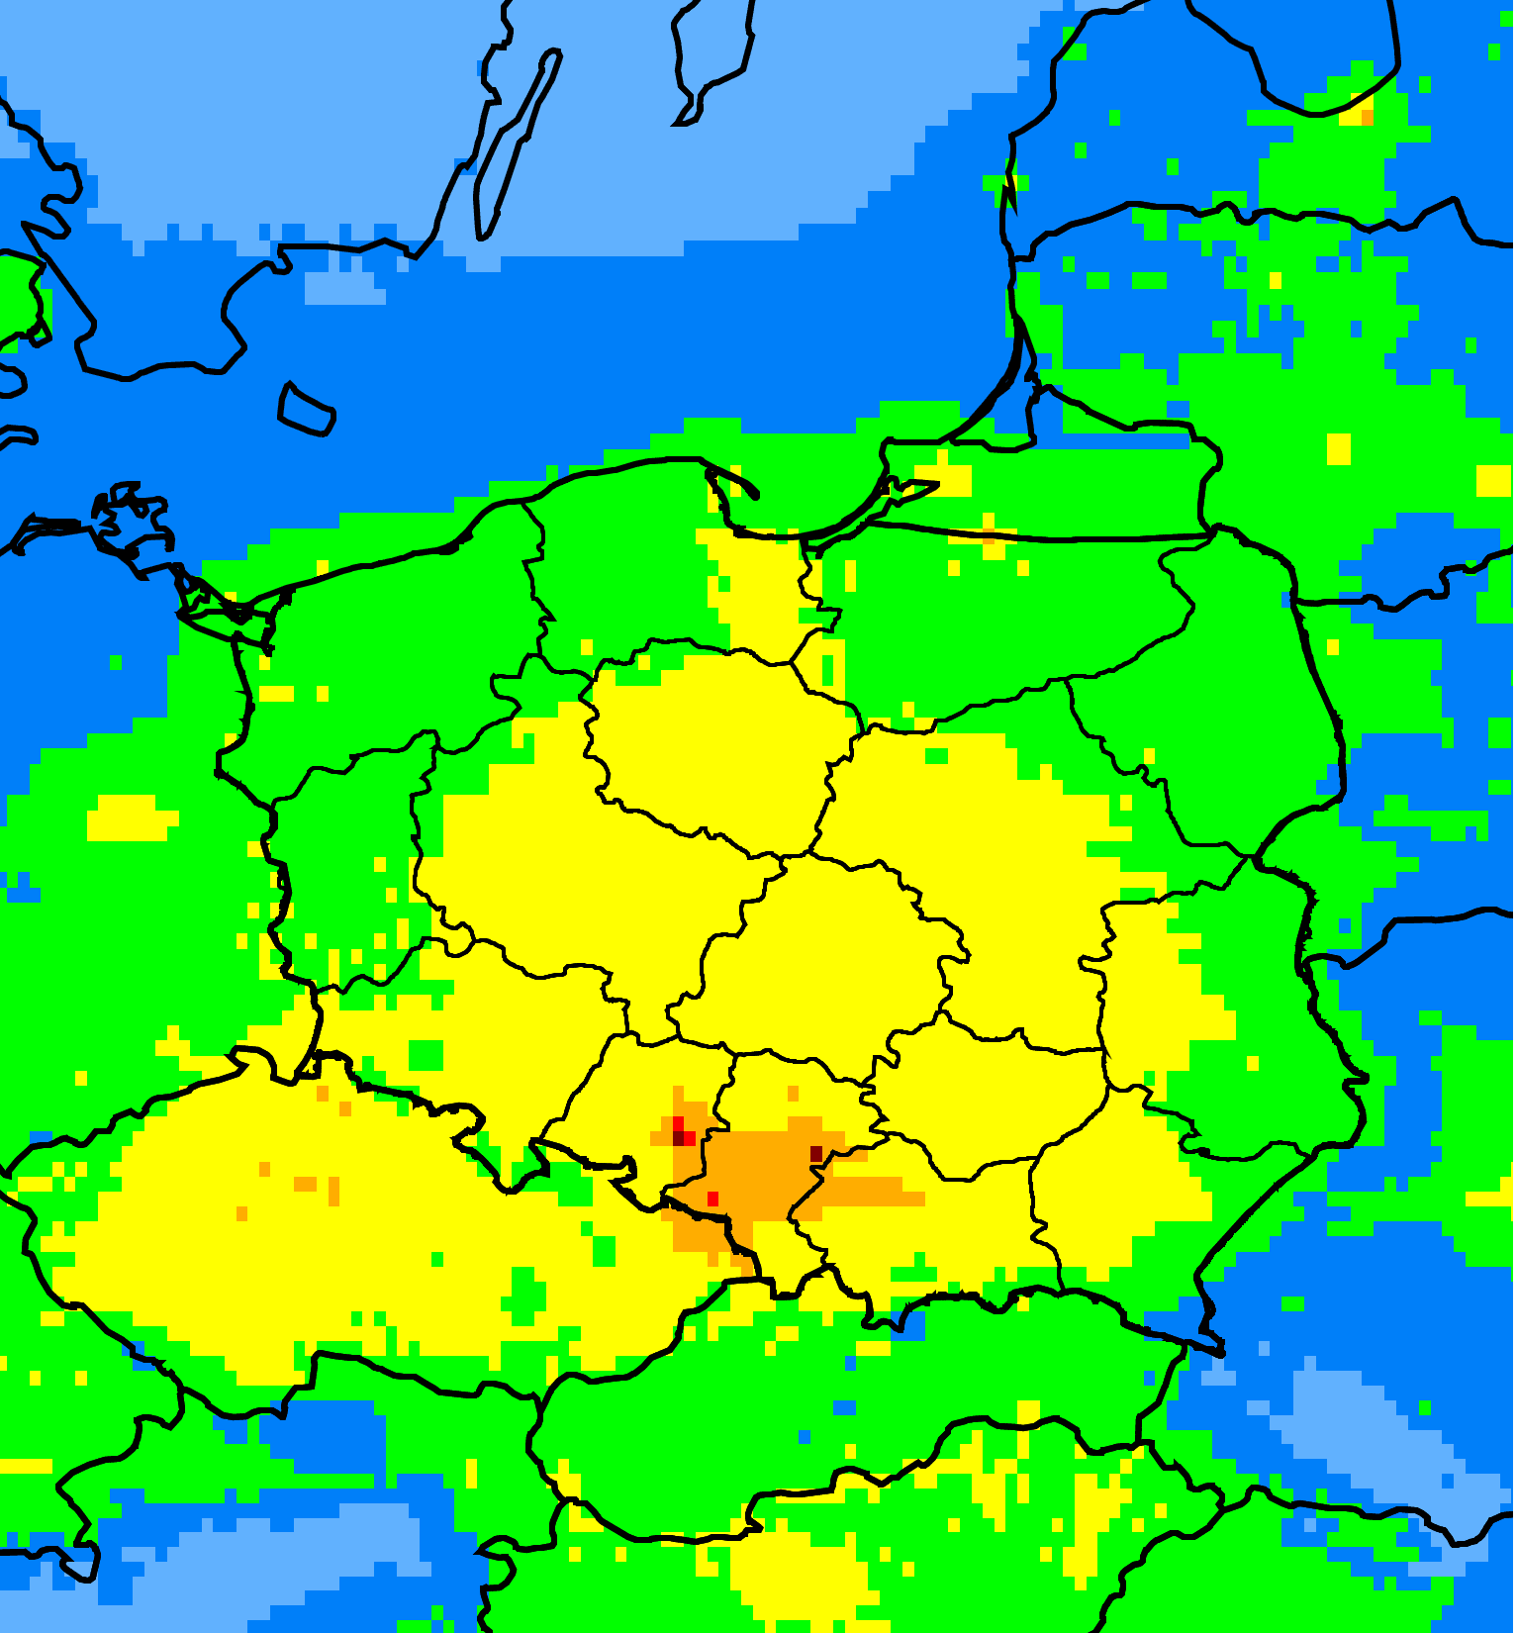
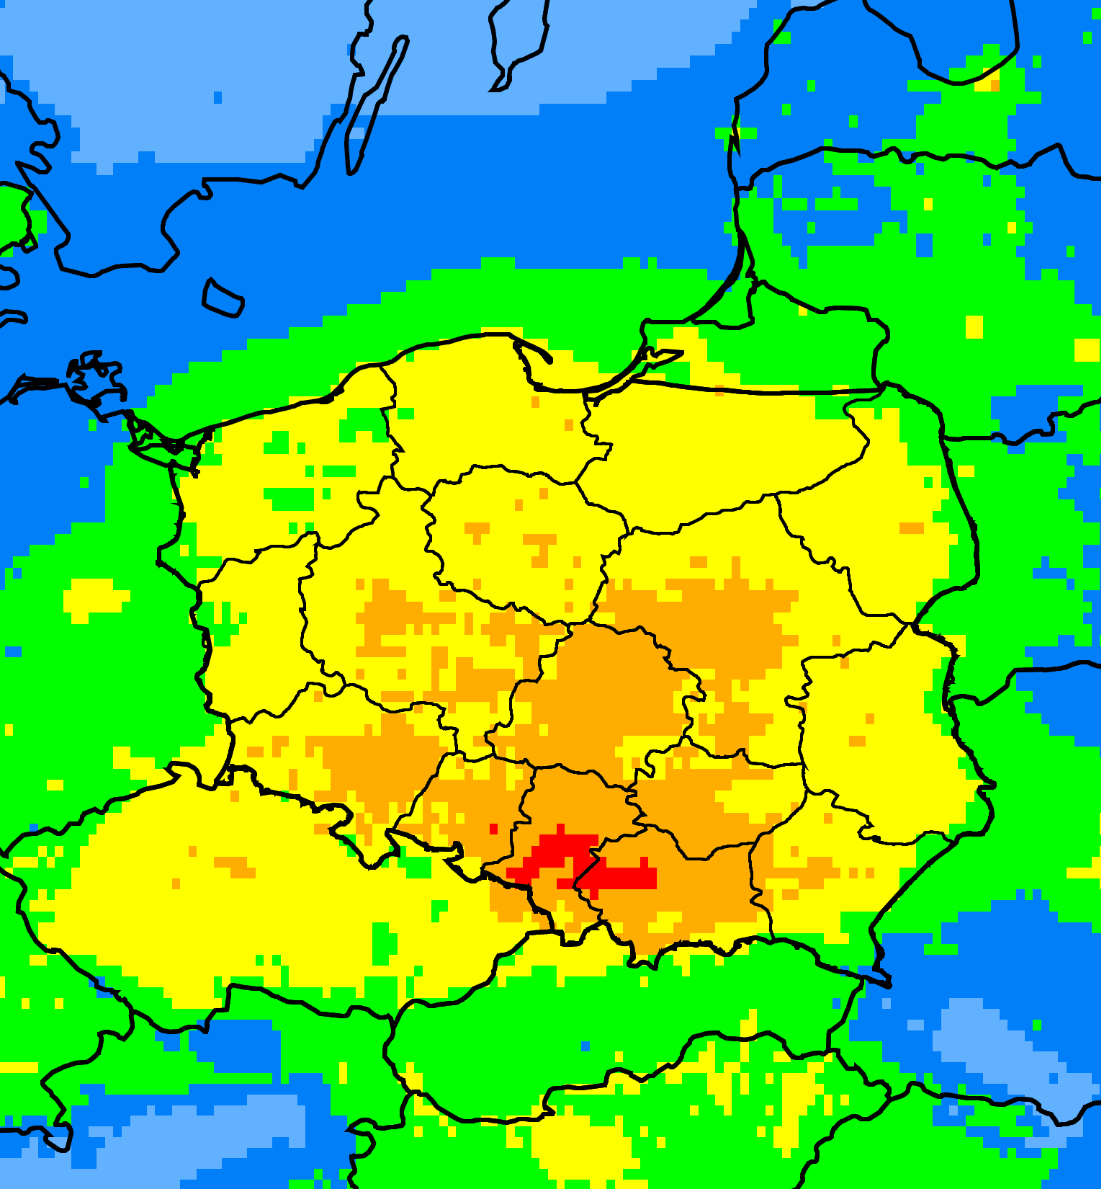
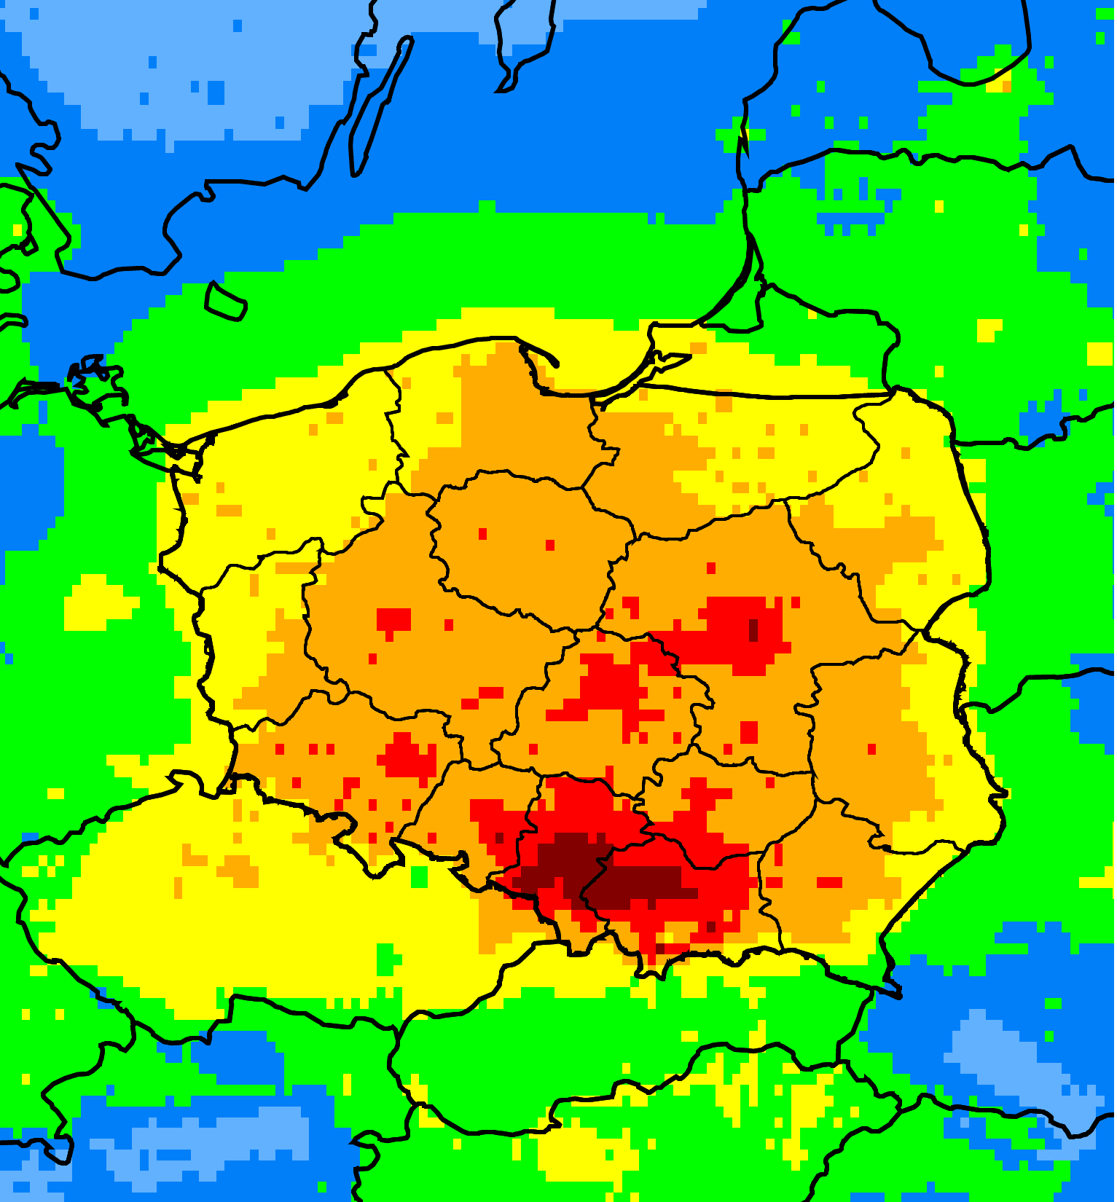
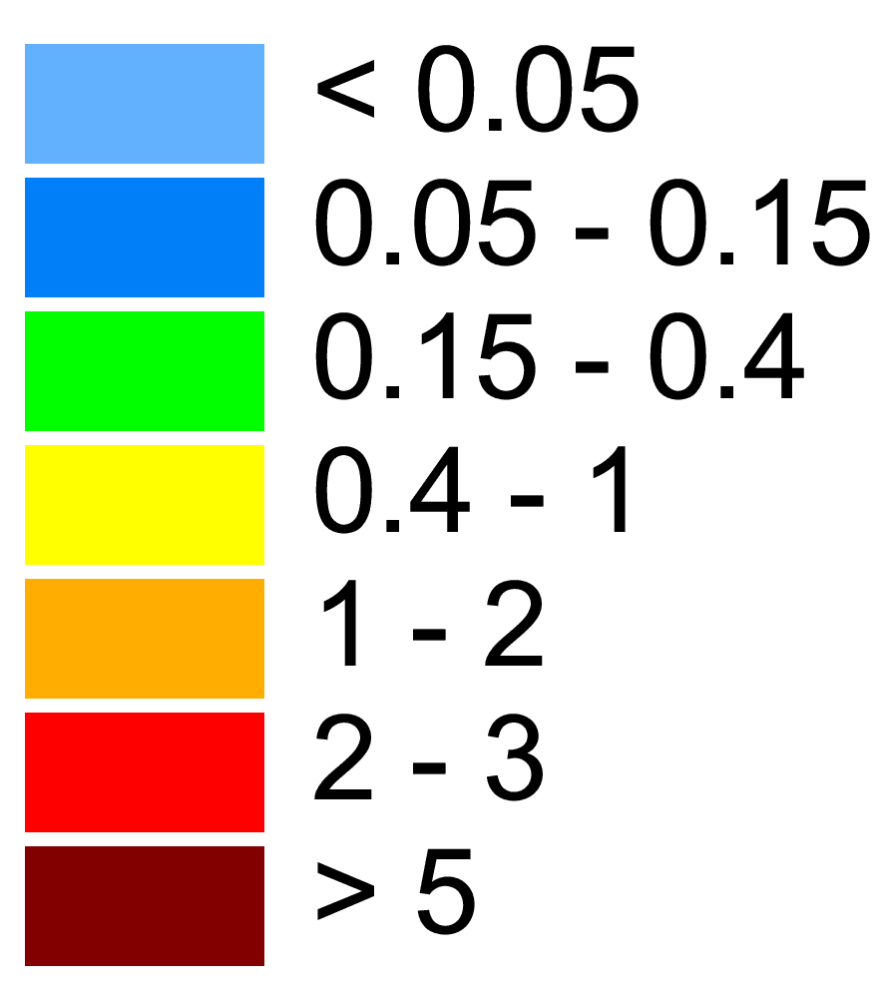
Model simulations setup and results
Reference year: 2018
Model: GLEMOS (v2.2.1)
Emissions: B(a)P emission inventory (CEIP), including emission inventories of Poland (submitted in 2019 and 2020), and scenario emissions
Meteorology: ECMWF reanalysis, WRF pre-processing
Spatial resolution: 0.1x0.1 degrees
Measurements: EMEP data, EEA AQ e-reporting data (background rural and suburban stations)
Previous emission inventory
Updated emission inventory
Maximum emission scenario
Modelled B(a)P air concentrations, ng m⁻³

Slide 6
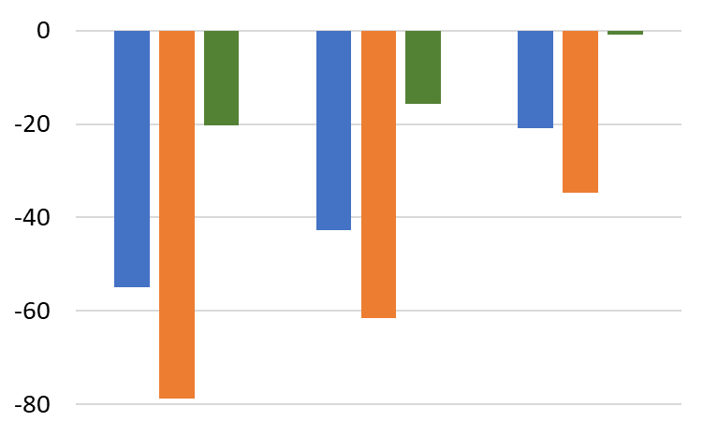
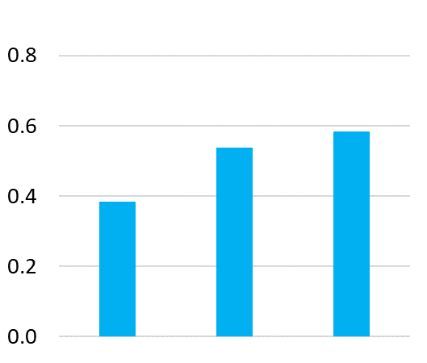
Modelled vs observed B(a)P pollution levels in Poland
Comparison with data of Background Rural stations for 2018 (n = 24):
Decrease of model bias from -55% to -20%
Increase of correlation from 0.4 to 0.6
Increase of Factor of 2 parameter from 30% to 50%
Bias, %
Correlation
Previous
Updated
Scenario emissions
Previous
Updated
Scenario emissions
All
Polish
Other stations

Slide 7
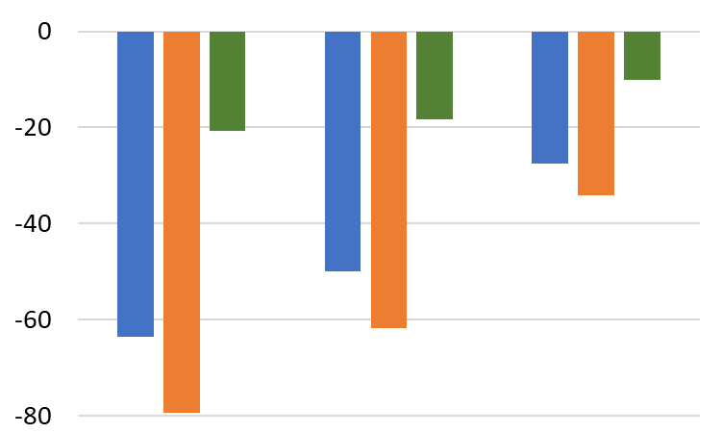
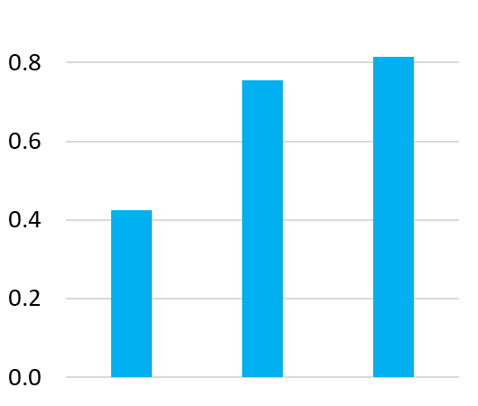
Modelled vs observed B(a)P pollution levels in Poland
Comparison with data of Background Rural + Suburban stations for 2018 (n = 56):
Decrease of model bias from -64% to -28%
Increase of correlation from 0.42 to 0.82
Increase of Factor of 2 parameter from 30% to 70%
Bias, %
Correlation
Previous
Updated
Scenario emissions
Previous
Updated
Scenario emissions
All
Polish
Other stations

Slide 8
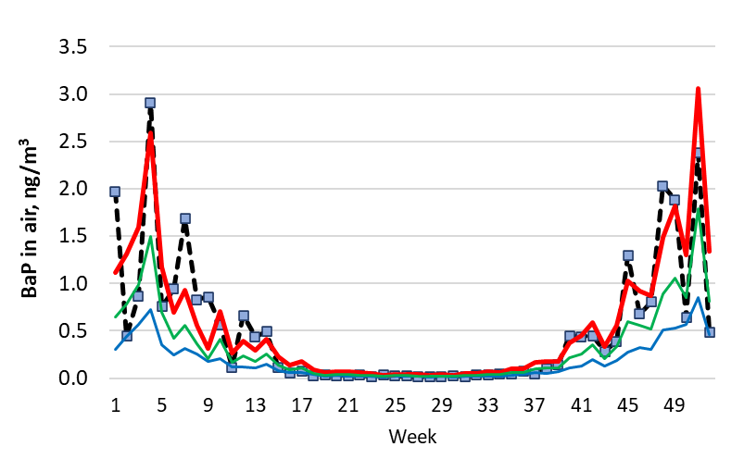
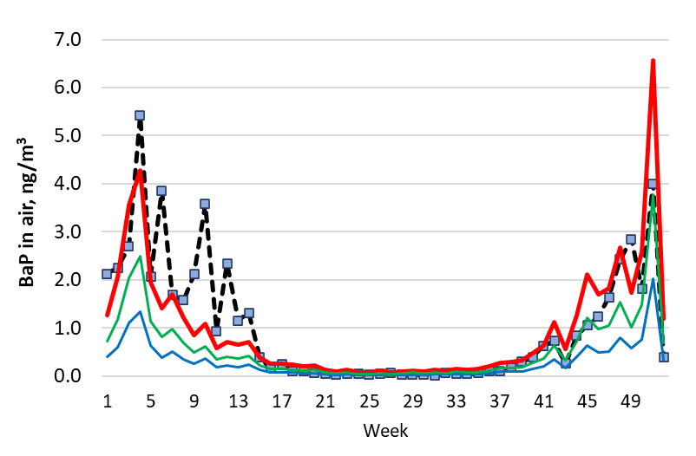
Modelled vs observed B(a)P pollution levels in Poland
Comparison with data of EMEP stations PL0005R and PL0009R for 2018:
Decrease of model bias from ~ -70% (previous emissions) up to ~ -5% (scenario emissions)
PL0005R
PL0009R
Modelled:
Observed
Previous emissions
Updated emissions
Scenario emissions

Slide 9
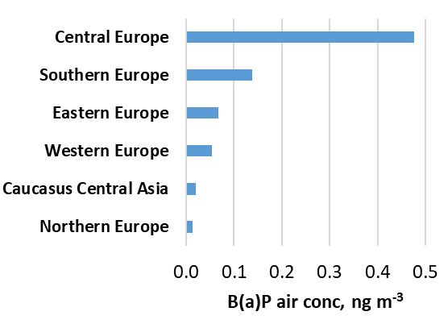
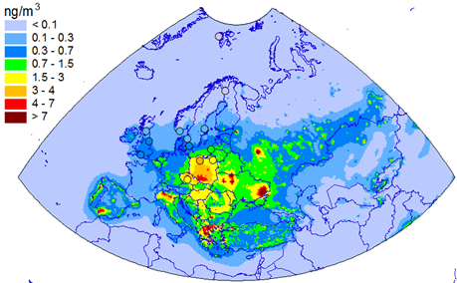
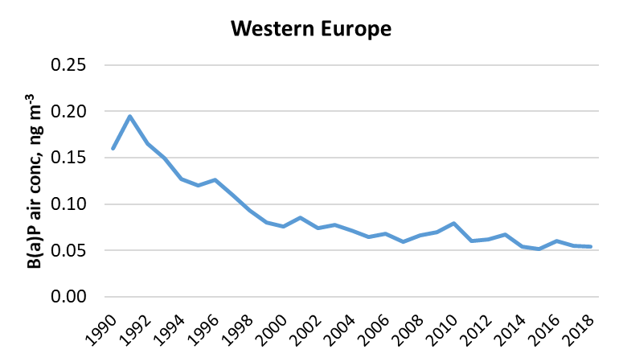
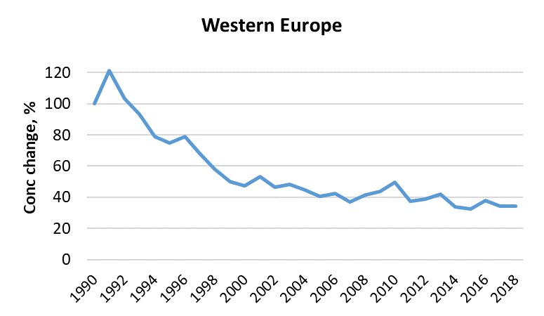
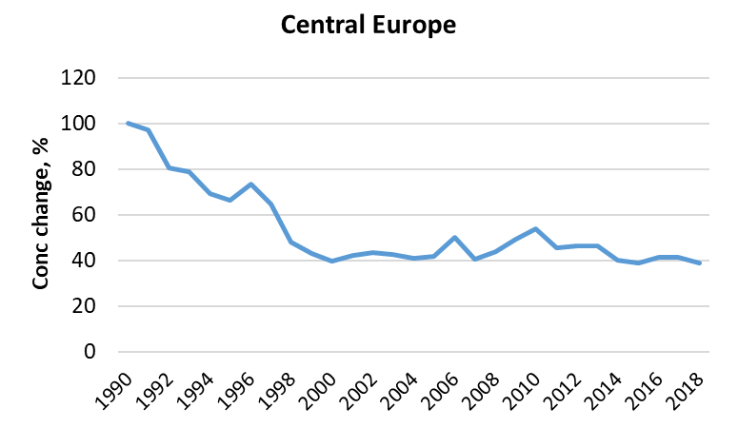
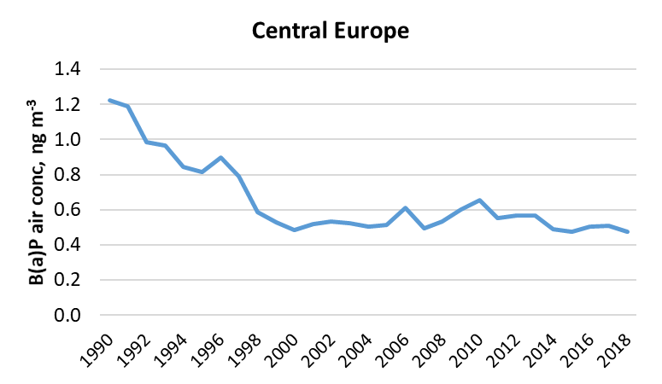
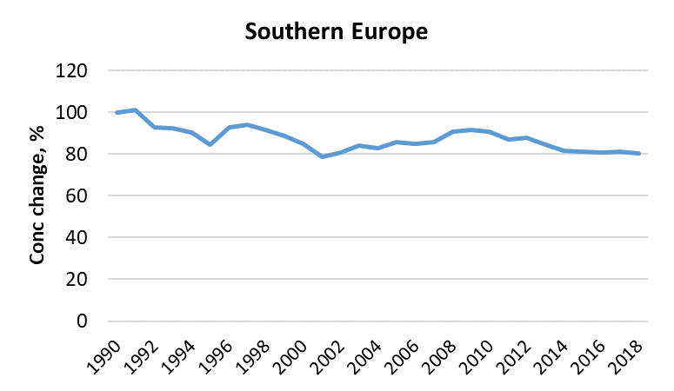
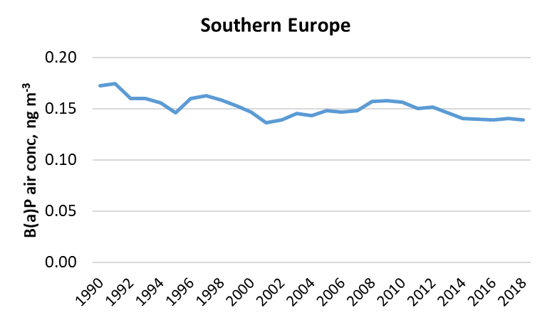
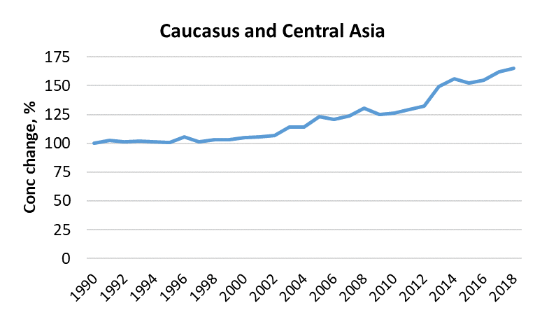
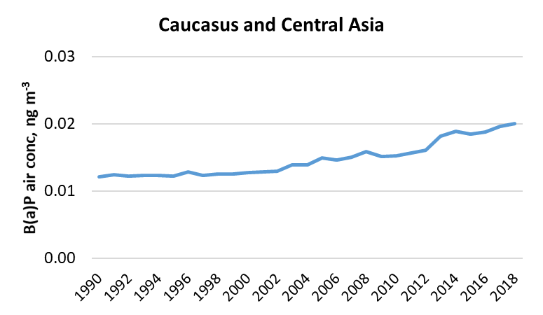
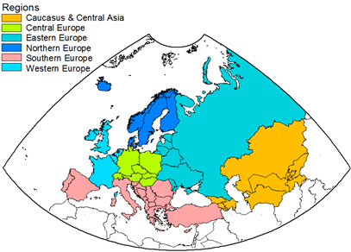
Long-term changes of PAH pollution in EMEP countries
Model estimates of B(a)P pollution trends (1990-2018):
Significant decrease in Western Europe
Small decrease/lack of changes in Central, Southern Europe after 2000
Increase in Caucasus and Central Asia
B(a)P concentrations (2018)
Sub-regions
Western Europe
Central Europe
Southern Europe
Caucasus & Central Asia
Long-term changes of B(a)P concentrations (relative values)
Long-term changes of B(a)P concentrations (absolute values)

Slide 10
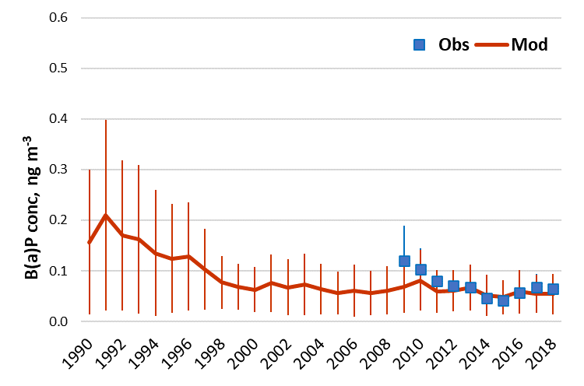
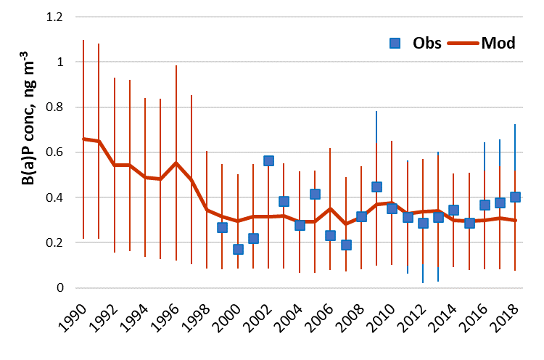
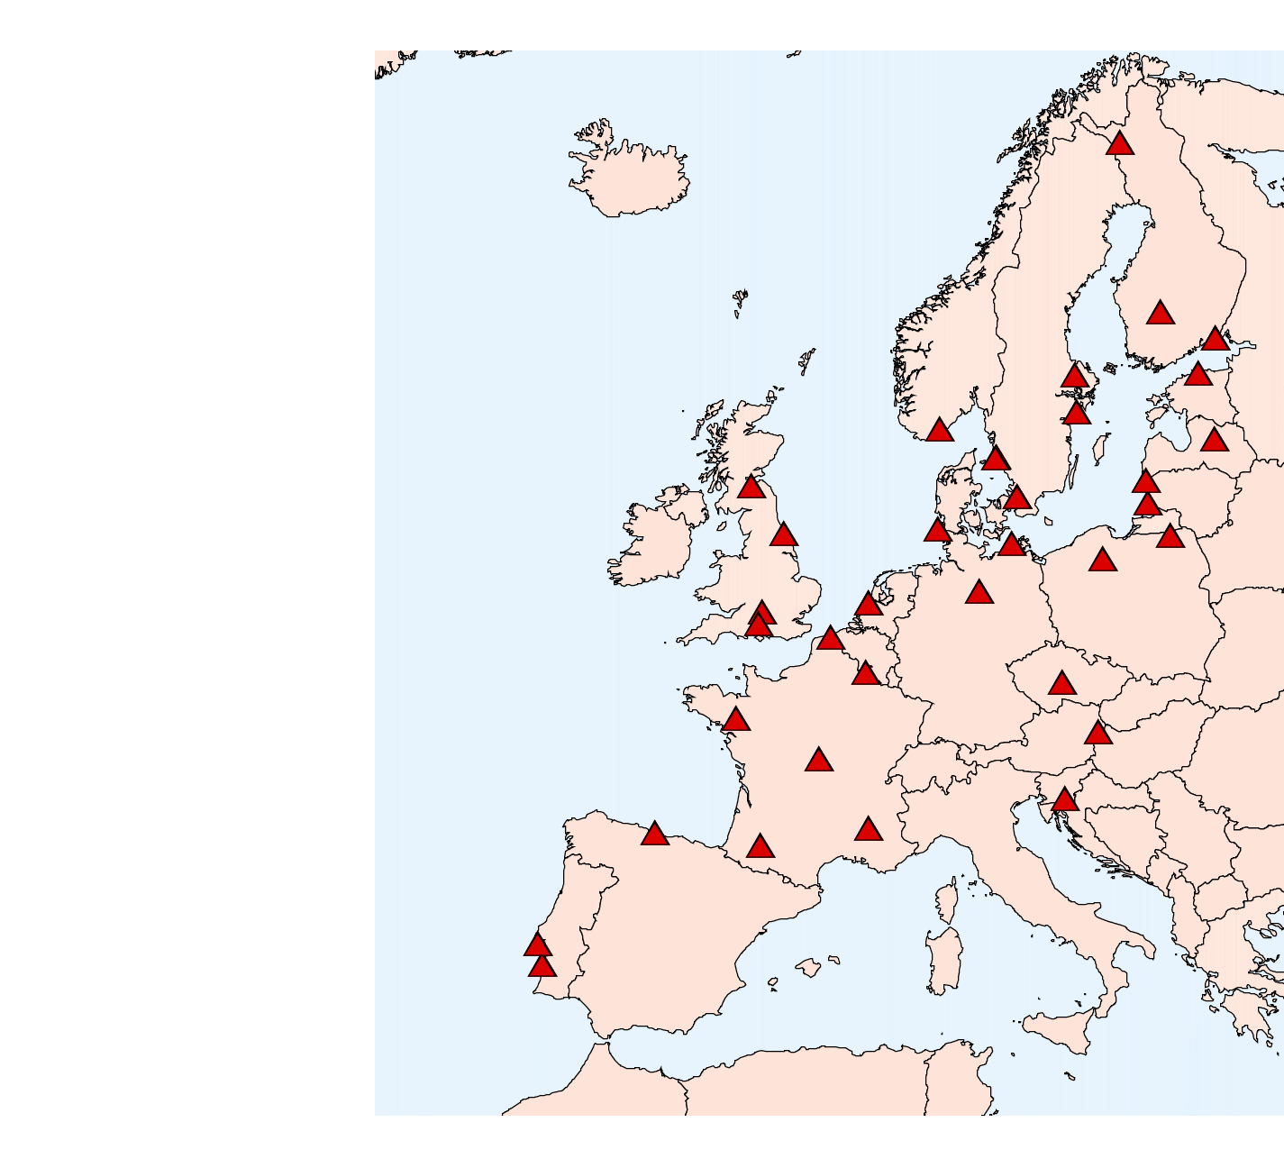
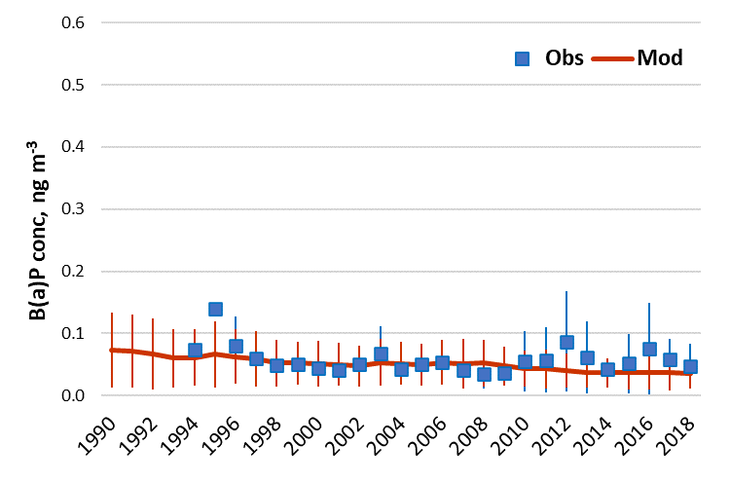
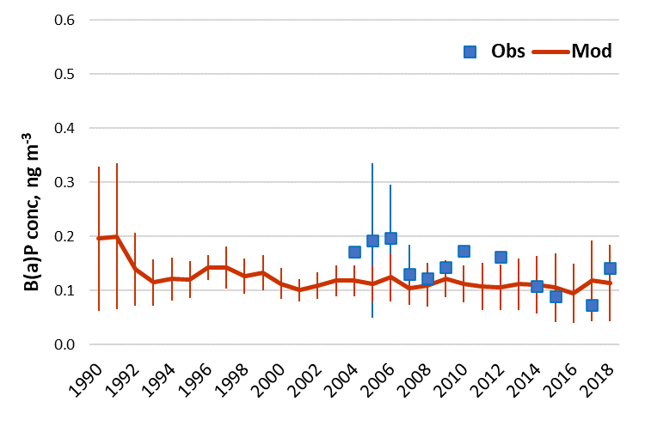
Modelled and observed B(a)P pollution trends
Evaluation of modelled B(a)P trends vs. long-term measurements (1990-2018):
Western Europe
Central Europe
EMEP monitoring stations (n = 40)
Northern Europe
Eastern Europe
Observed B(a)P concentrations
Modelled B(a)P concentrations

Slide 11
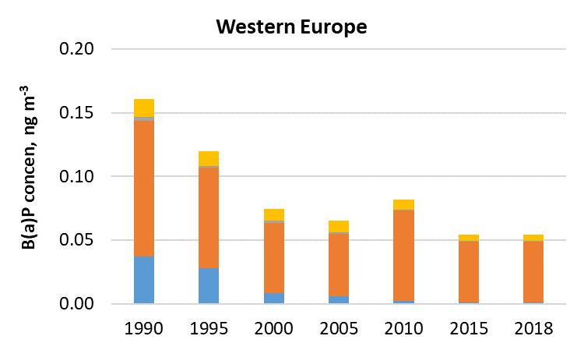
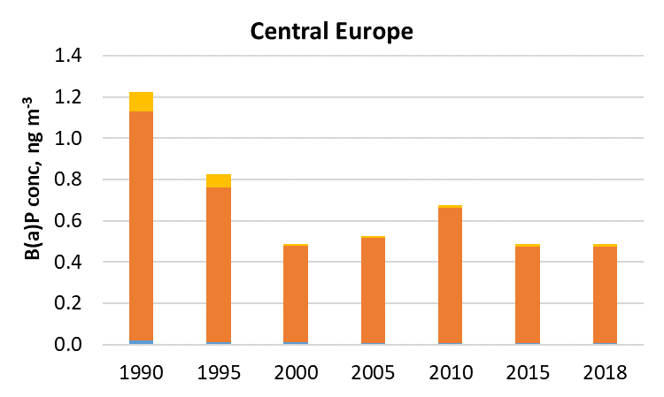
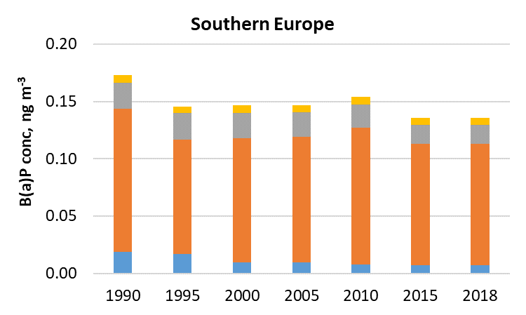
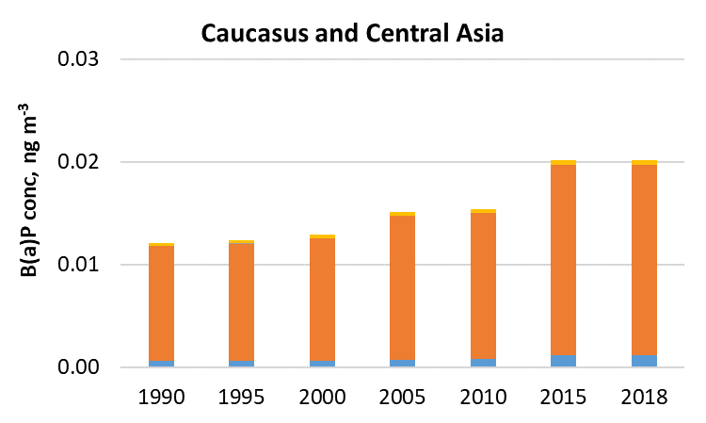
PAH pollution trends: contributions of key emission sectors
Long-term changes of emission sector contributions to B(a)P concentrations (1990-2018):
Key emission sectors
Industry
Residential Combustion
Agriculture
Other
Sub-regions
Western Europe
Central Europe
Southern Europe
Caucasus & Central Asia

Slide 12
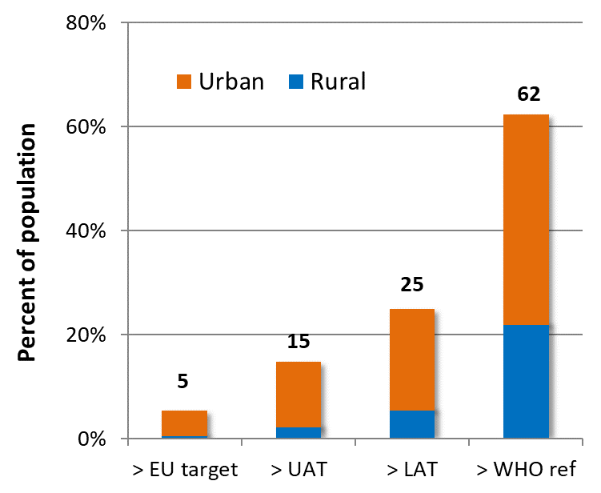
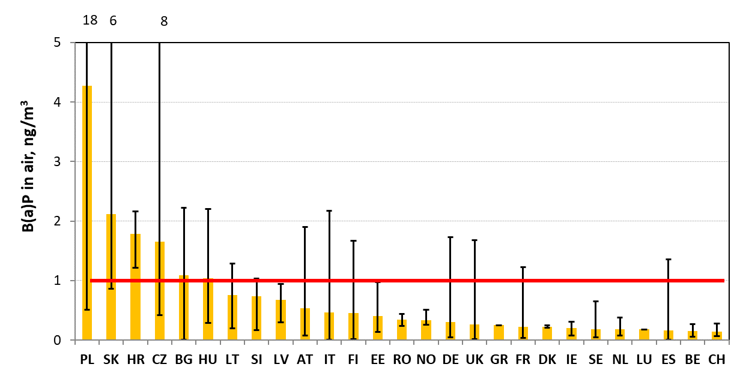
PAH pollution and population exposure
No significant decrease of observed and modelled B(a)P pollution levels
Exceedances of air quality guidelines still exist in some of EMEP countries
Importance to consider population exposure to mixture of toxic PAHs (e.g. 16 PAHs)
EMEP population in areas with exceeded B(a)P limits
Annual mean observed B(a)P concentrations and exceedances of EU target level (2018)
Mean Obs
EU target
Results of B(a)P/PAH pollution levels and trends assessment will be discussed at the meeting of TF Health (11 May, 2021) and summarized in MSC-E Technical Report
1.0
0.6
0.4
0.12 ng/m³
Estimated based on model results for 2018
Measurements from EEA AQ-Reporting for 2018

Slide 13
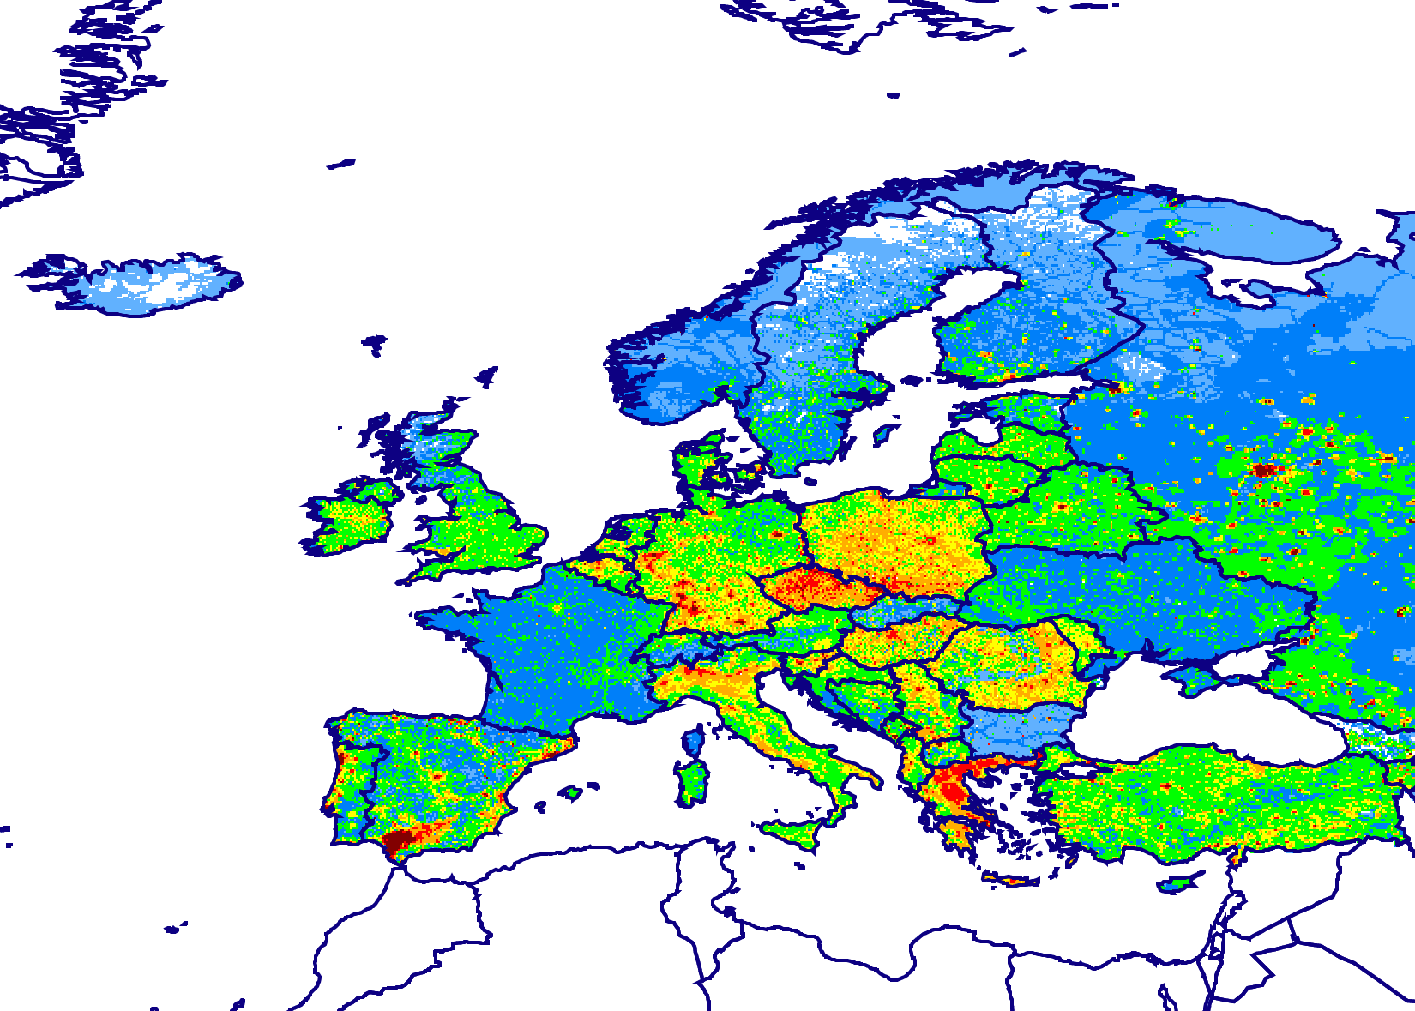
Multi-model study of B(a)P pollution
Contribution to EuroDelta-Carb model intercomparison project (TFMM)
Objectives:
Multi-model assessment of B(a)P pollution levels and exceedances of air quality guidelines
Analyzing relationship between B(a)P and PM transport and fate (including PM components – OC, EC)
Contribute to analysis of consistency of residential wood burning emissions
Model domain and B(a)P emissions
Modeling groups:
Institution | Model | Experts
EMEP/MSC-E | GLEMOS | Alexey Gusev
INERIS (France) | CHIMERE | Augustin Colette
FMI (Finland) | SILAM | Rostislav Kouznetsov, Evegeny Kadantsev
CIEMAT (Spain) | CHIMERE | Marta Garcia Vivanco
ENEA (Italy) | MINNI | Mihaela Mircea, Ilaria Delia, Mario Adani

Slide 14
Multi-model study of B(a)P pollution
Summary of Eurodelta-Carb on BaP discussion meeting held on 19 April 2021
Model setup: Identical to PM phase of Eurodelta-Carb, except for emissions and temporal coverage
Temporal coverage: 20171201-20181231 to cover EMEP/ACTRIS/COLOSSAL IMP (winter 2017/2018) and also allow annual coverage
Emissions of B(a)P: CEIP emission inventory for 2018
Emissions of non-B(a)P species: recommendation to use CAMS-REG-AP/REF2.1 (as implemented in CAMS50 as of June 2021)
Observations: EMEP and EEA AQ e-reporting measurement data for 2017/2018
Model simulations: Base case model run Sensitivity model runs (could be agreed at a later stage)
EEA AQ e-reporting measurement data for 2018

Slide 15
Timeline and participation
Task | Deadline
Agree on experiment design | May 2021 (TFMM)
All input data available (inc. emissions provided by MSC-E) | June 2021
Complete model runs | Sep/Oct 2021
Teleconference for preliminary analysis | Nov 2021
Teleconference for final results | Mar 2022
Final presentation at TFMM | May 2022
MSCE/INERIS/ENEA/FMI run the models
CCC/NILU expertise on observations
EEA/ETC expertise on AQ e-reporting measurement data
MSCE/CIEMAT analysis of results

Slide 16
Ongoing and further EMEP activities on PAHs
Research activities
Multi-model analysis of B(a)P pollution in 2017/2018 using data of intensive winter monitoring campaign (EuroDelta-Carb)
Case study on B(a)P pollution in Poland
Analysis of long-term changes of PAH pollution on global/regional scale (in co-operation with TF HTAP)
Co-operation
Data exchange with TF Health on B(a)P/PAH concentration and exceedances of target values to assess population exposure
Co-operation with international organizations (HELCOM, …)

